Slide 1

Educating the Atomic Human
Neil D. Lawrence

Slide 2
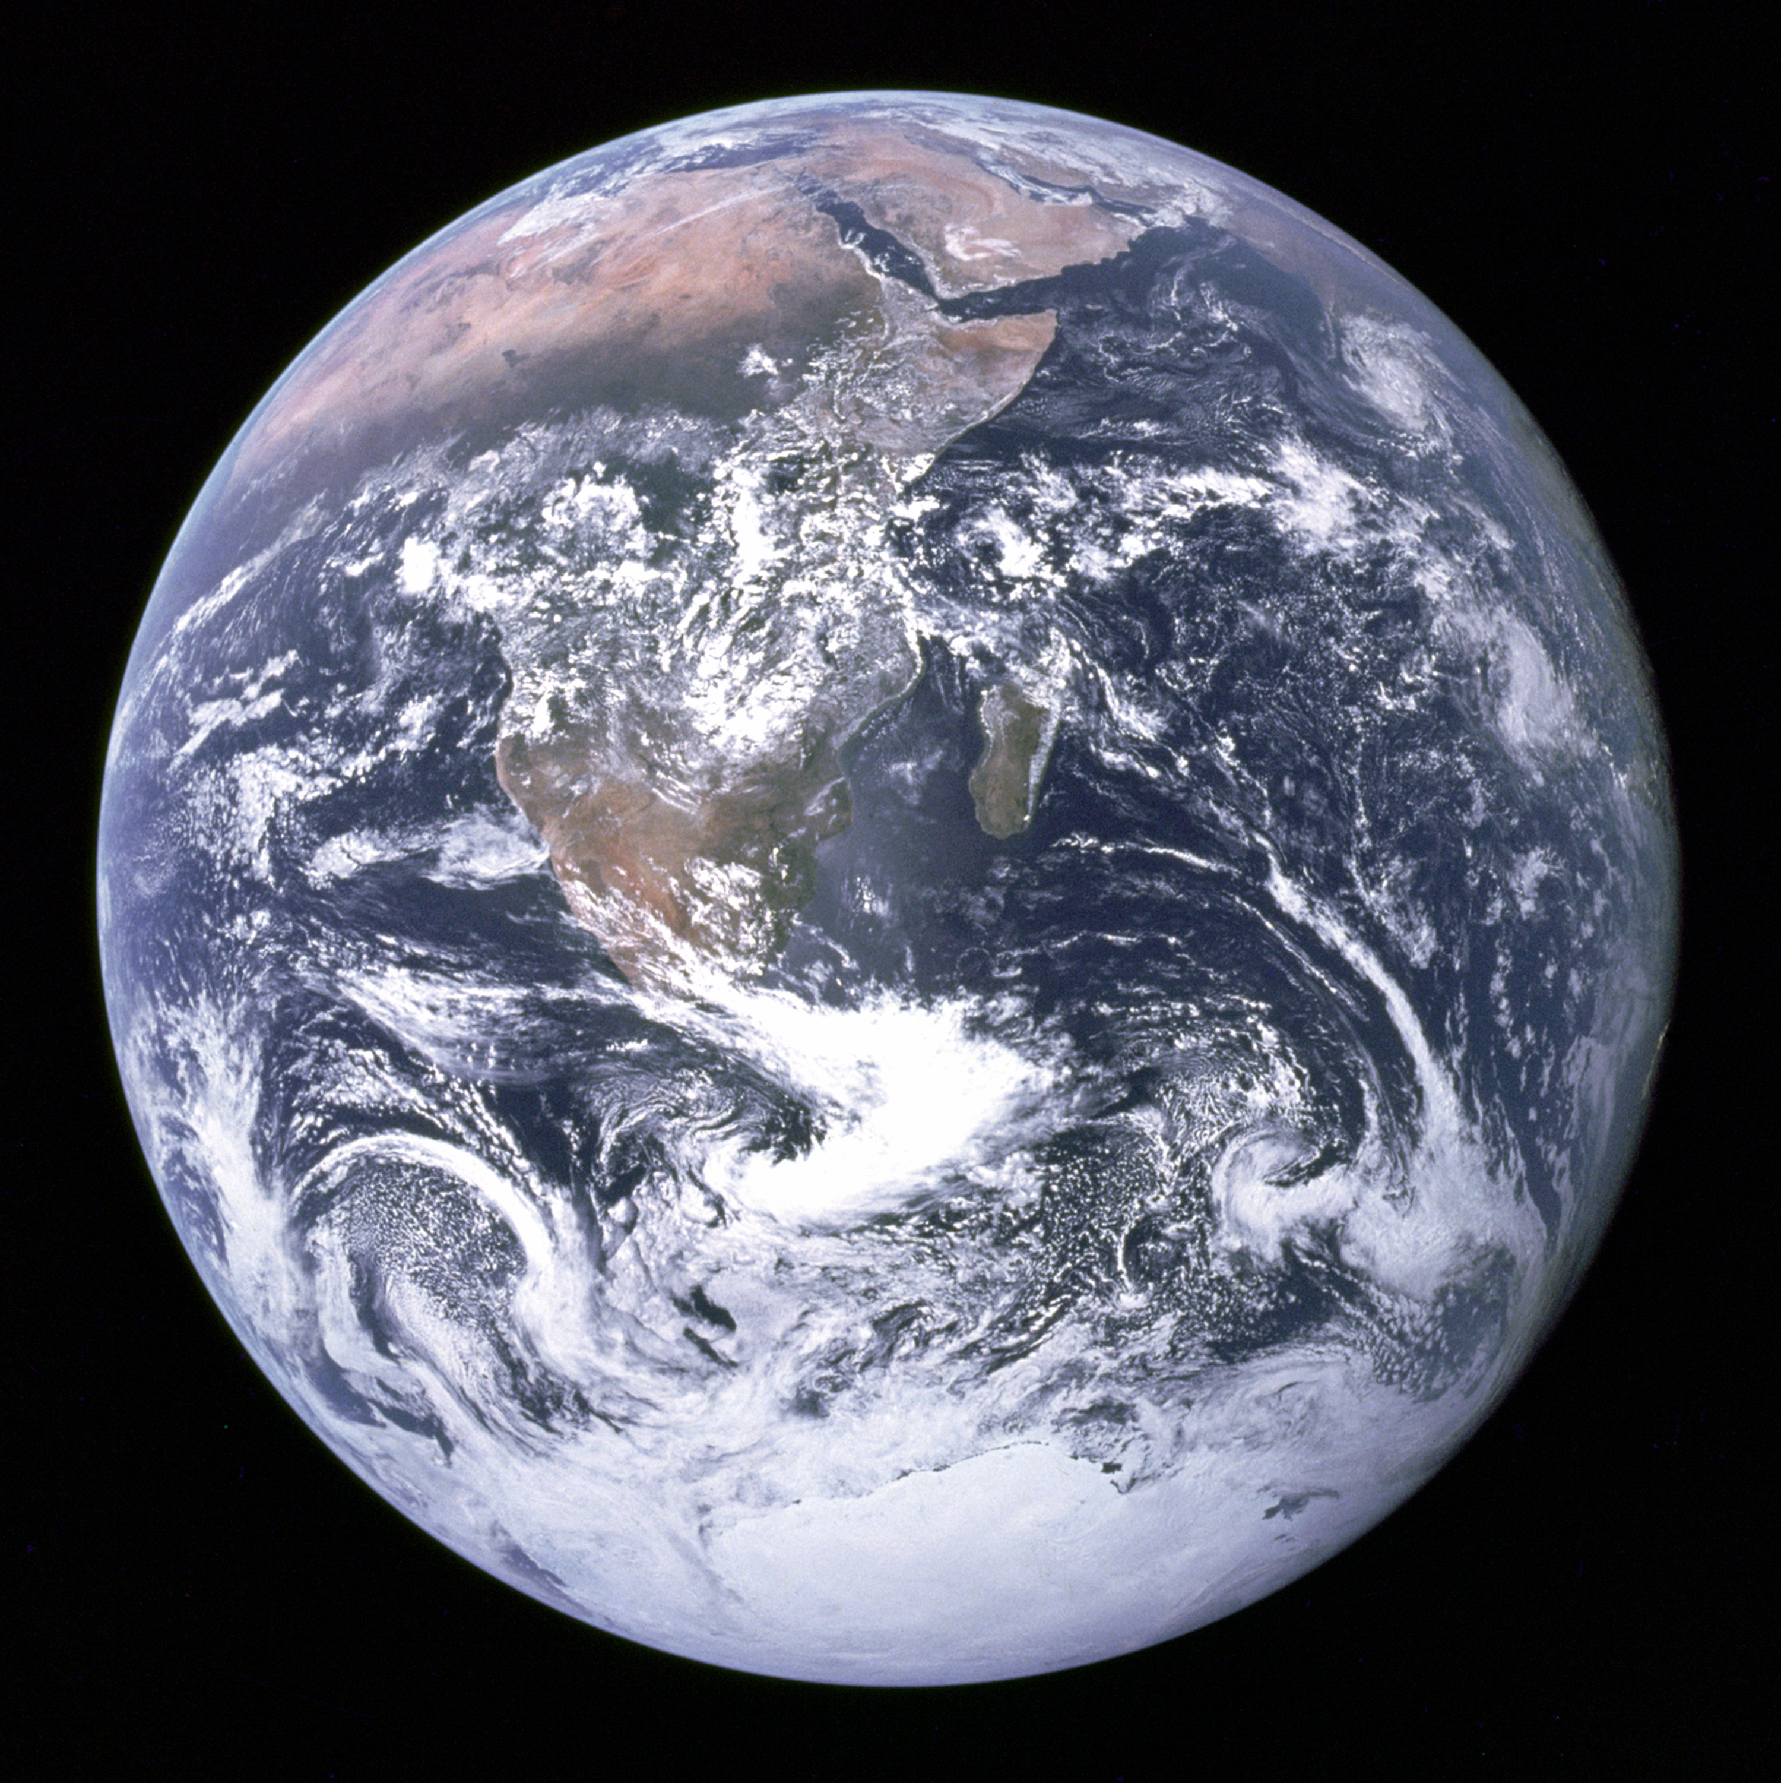
Notes:
The ”Blue Marble” photographed by Apollo 17.

Slide 3
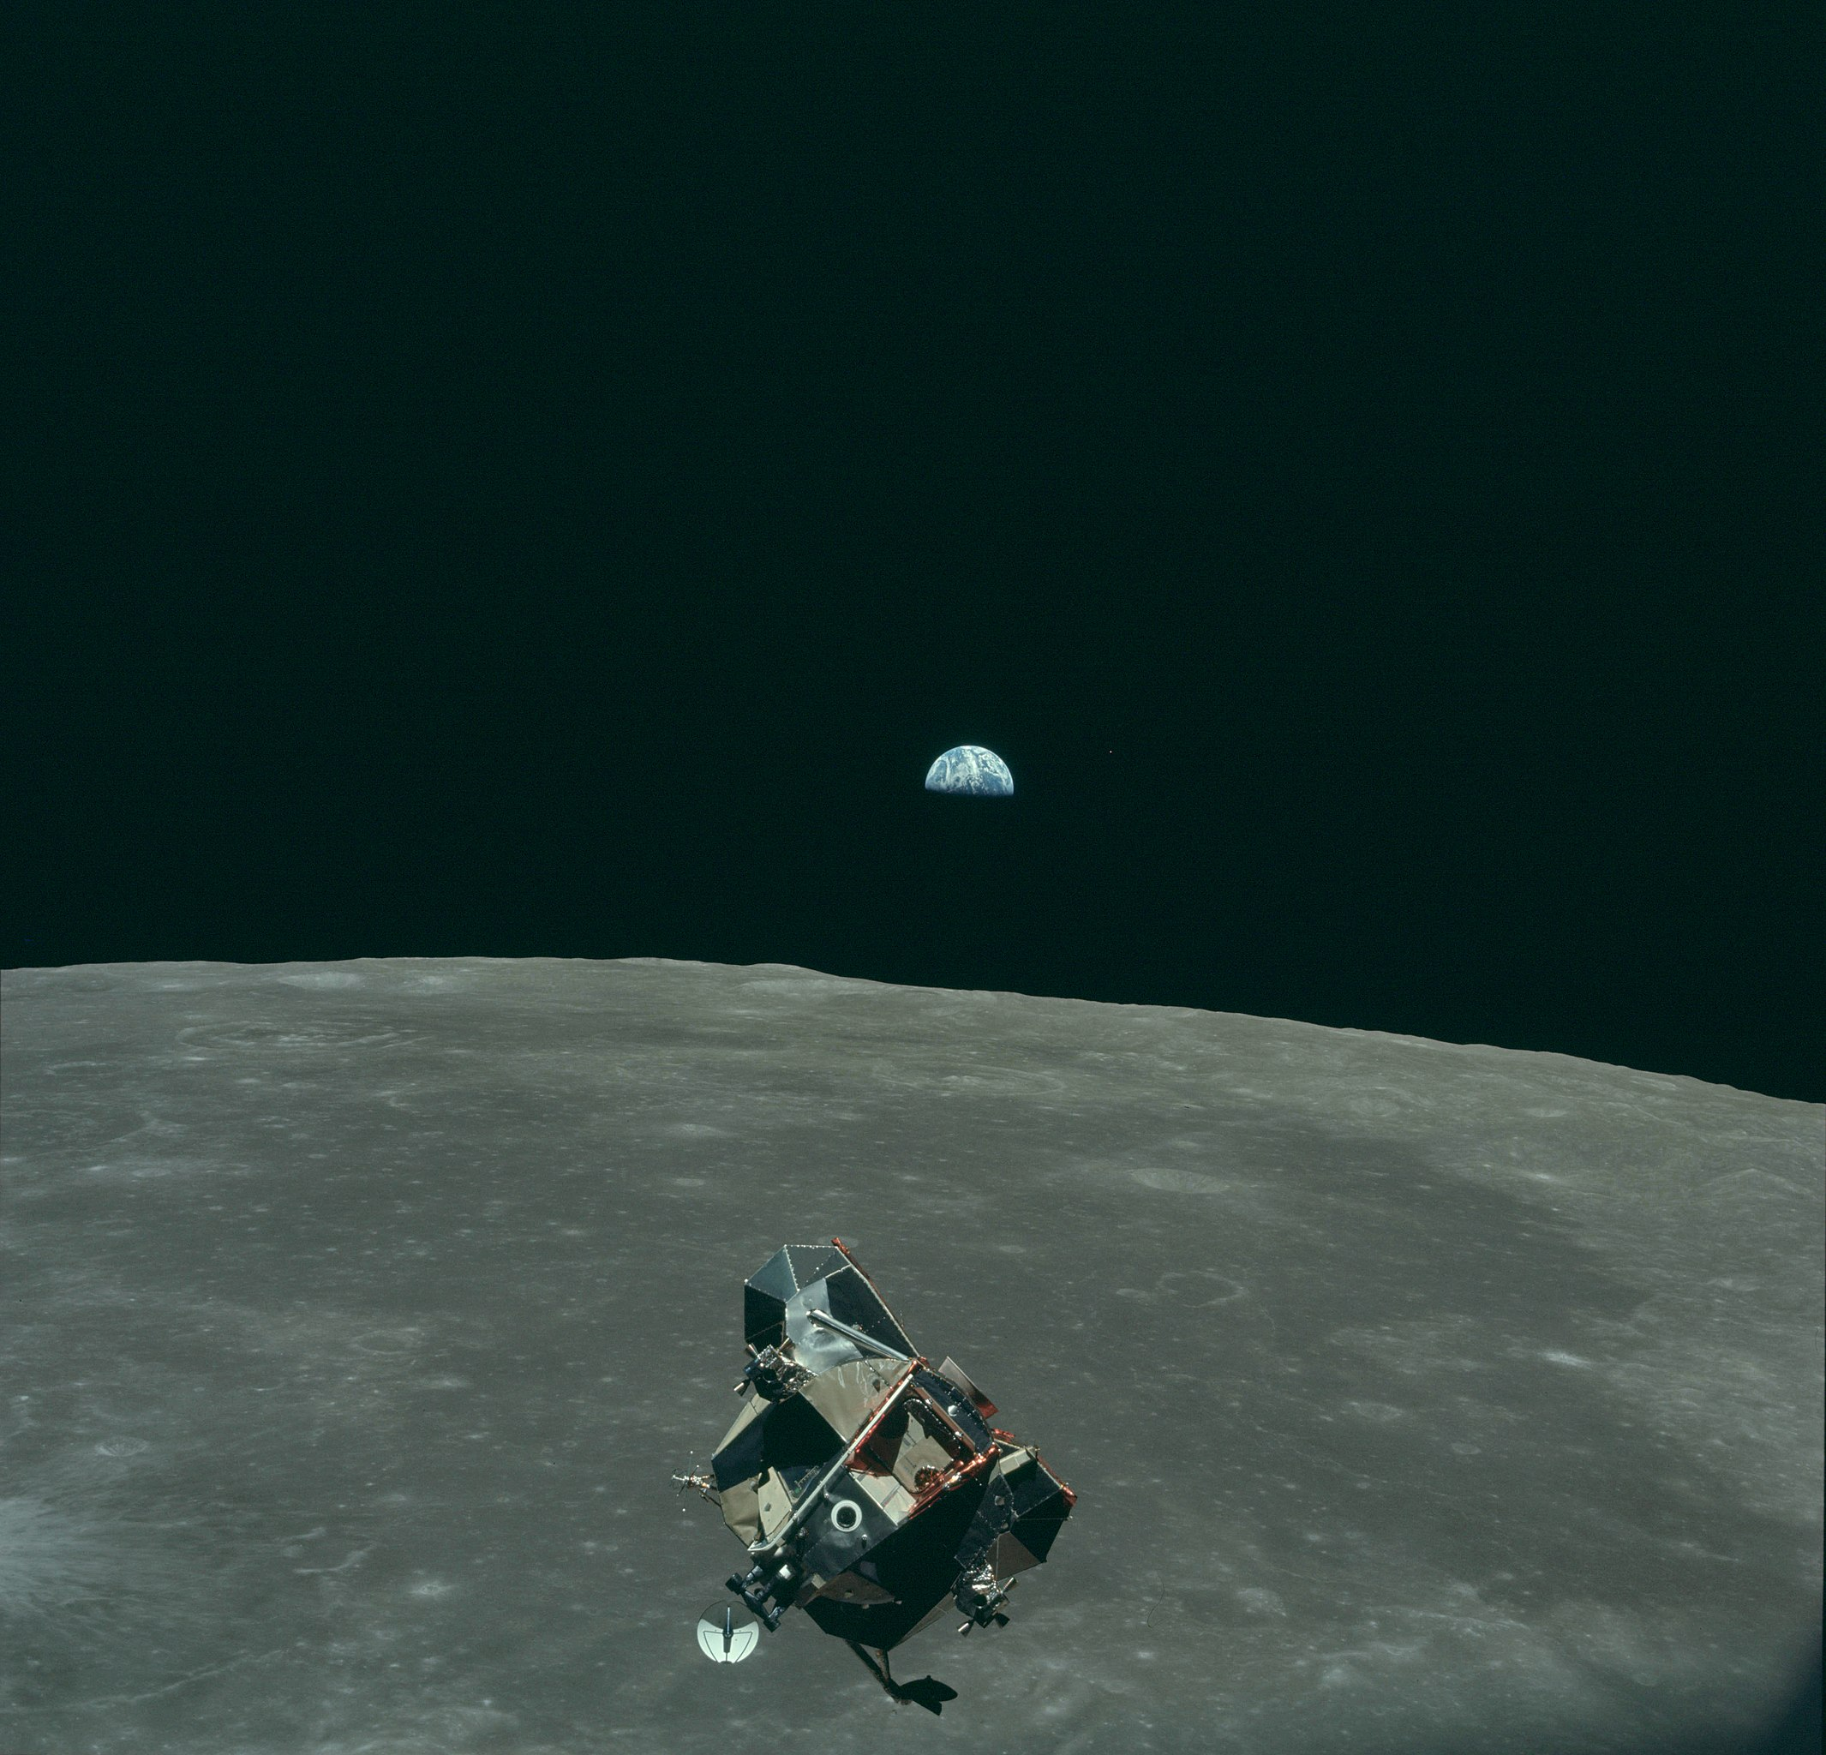

Slide 4
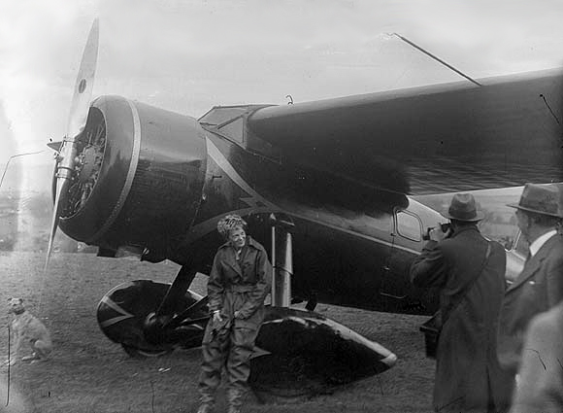

Slide 5
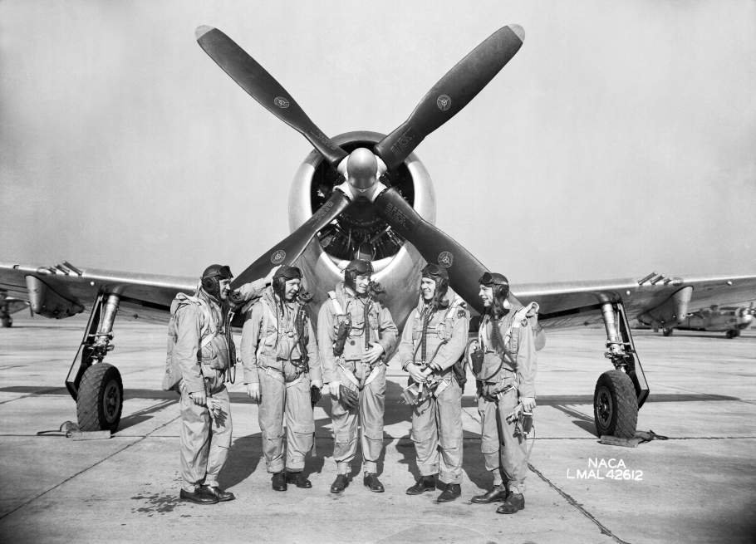
Notes:
NACA test pilots, bob gilruth

Slide 7
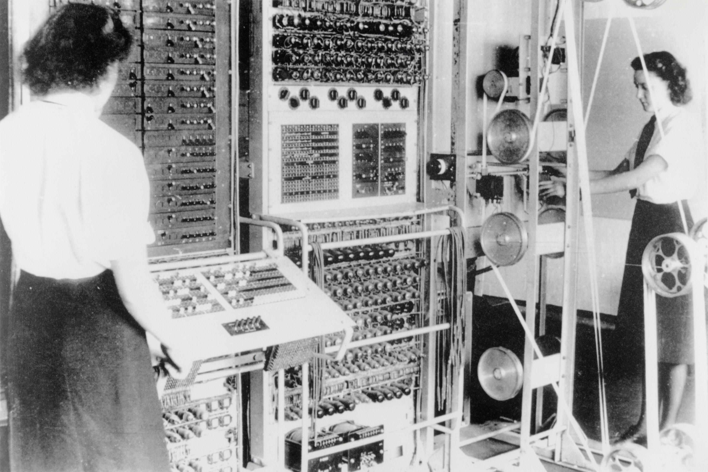
Notes:
A mark 2 colossus based at Bletchley Park being operated by Dorothy Du Boisson (left) and Elsie Booker (right)

Slide 8
bits/minute
2000
billions
a billion
billion
calculations/s
trillions
15 billion
years
20
minutes
embodiment

Slide 9
classical
statistics
data
science

Slide 10
?
!#@%&?
#
!
&
!
£*?$&!
&
?
#

Slide 11
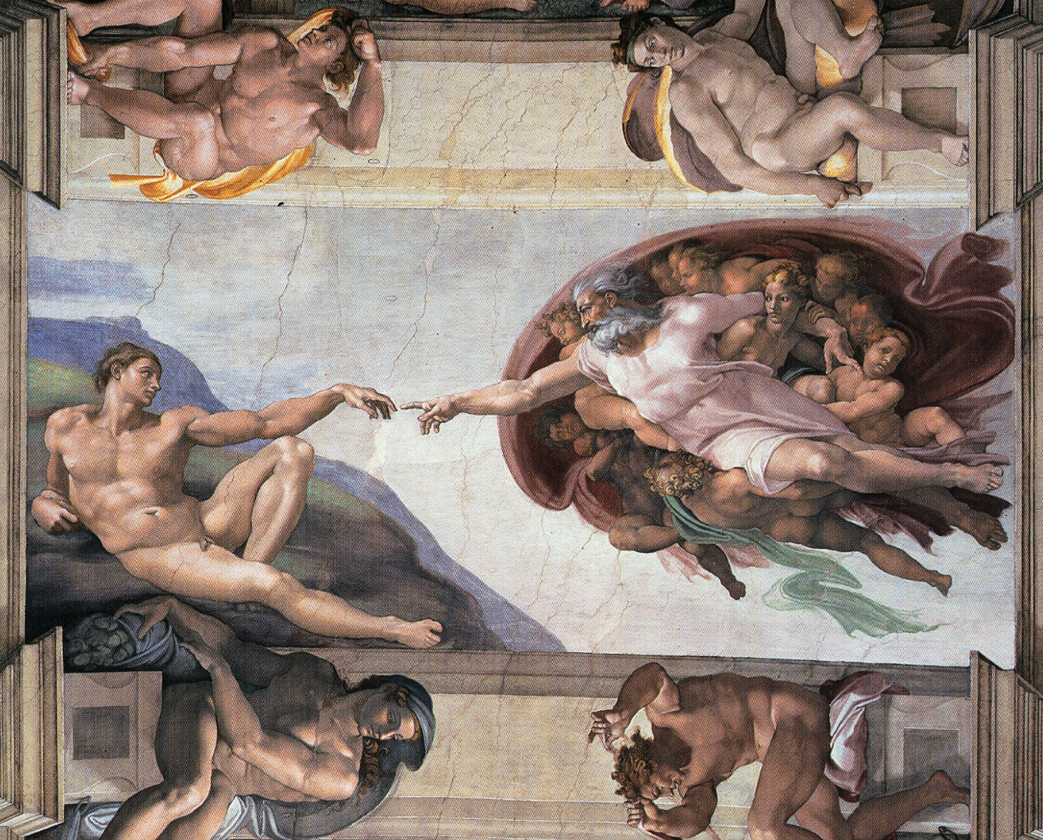

Slide 12
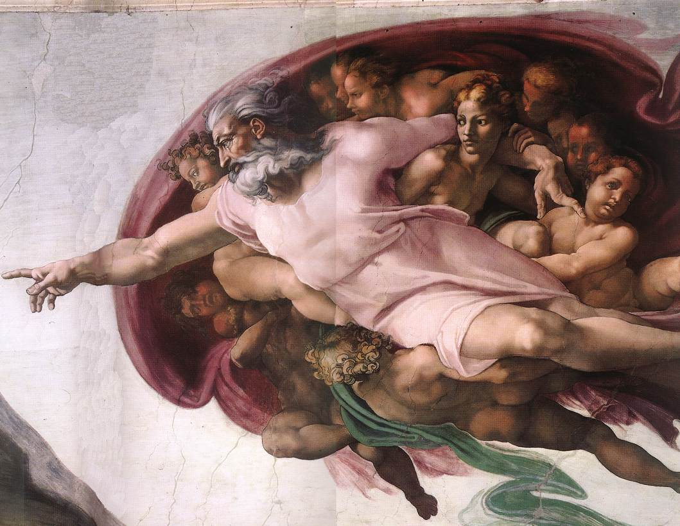

Slide 13
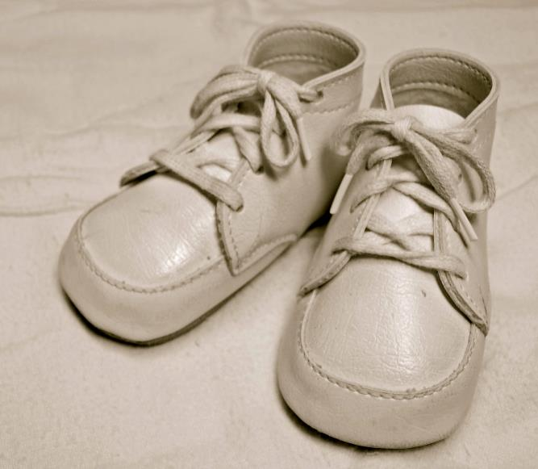
For Sale, Baby Shoes, Never Worn

Slide 14
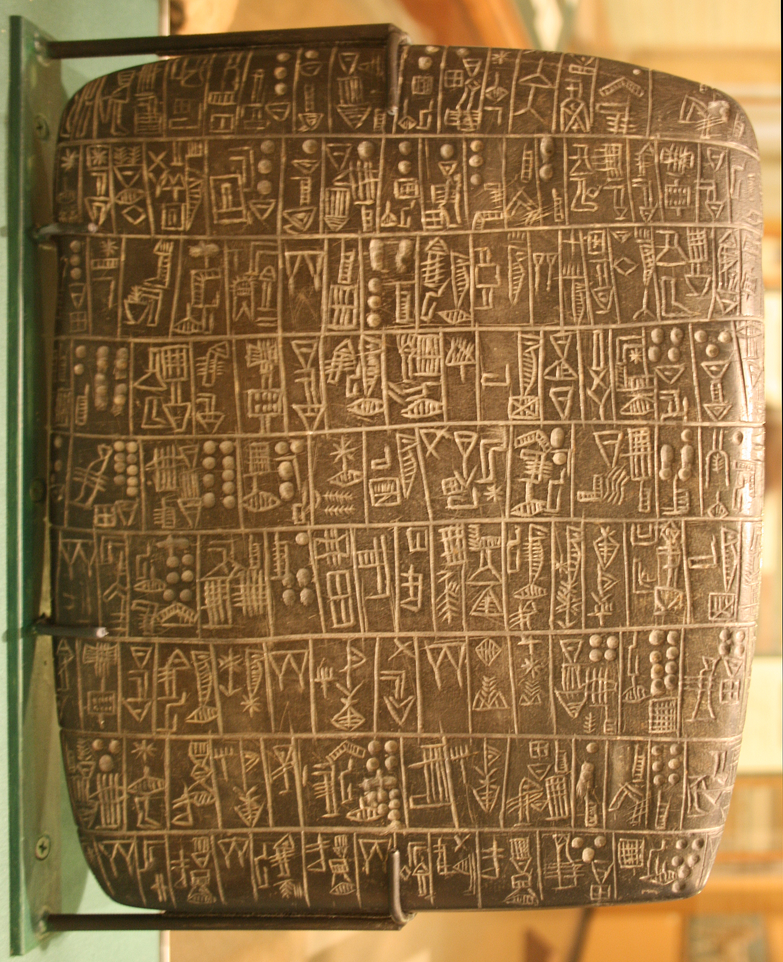
Notes:
Chicago Stone, side 2, recording sale of a number of fields, probably from Isin, Early Dynastic Period, c. 2600 BC, black basalt

Slide 15


Slide 16
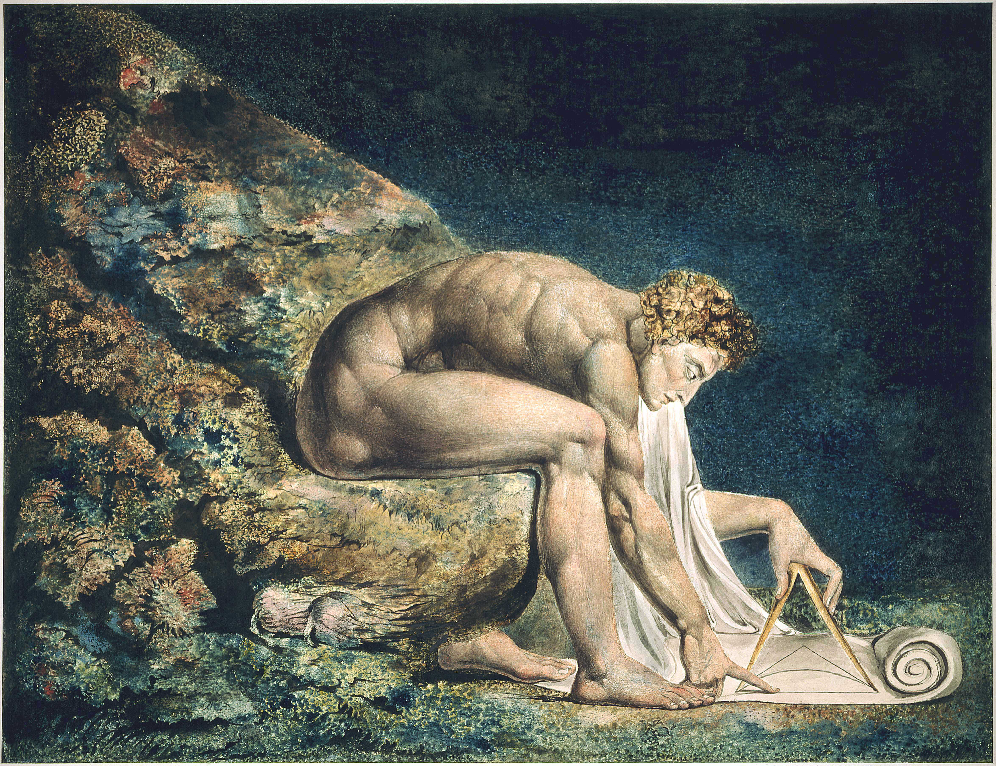

Slide 17
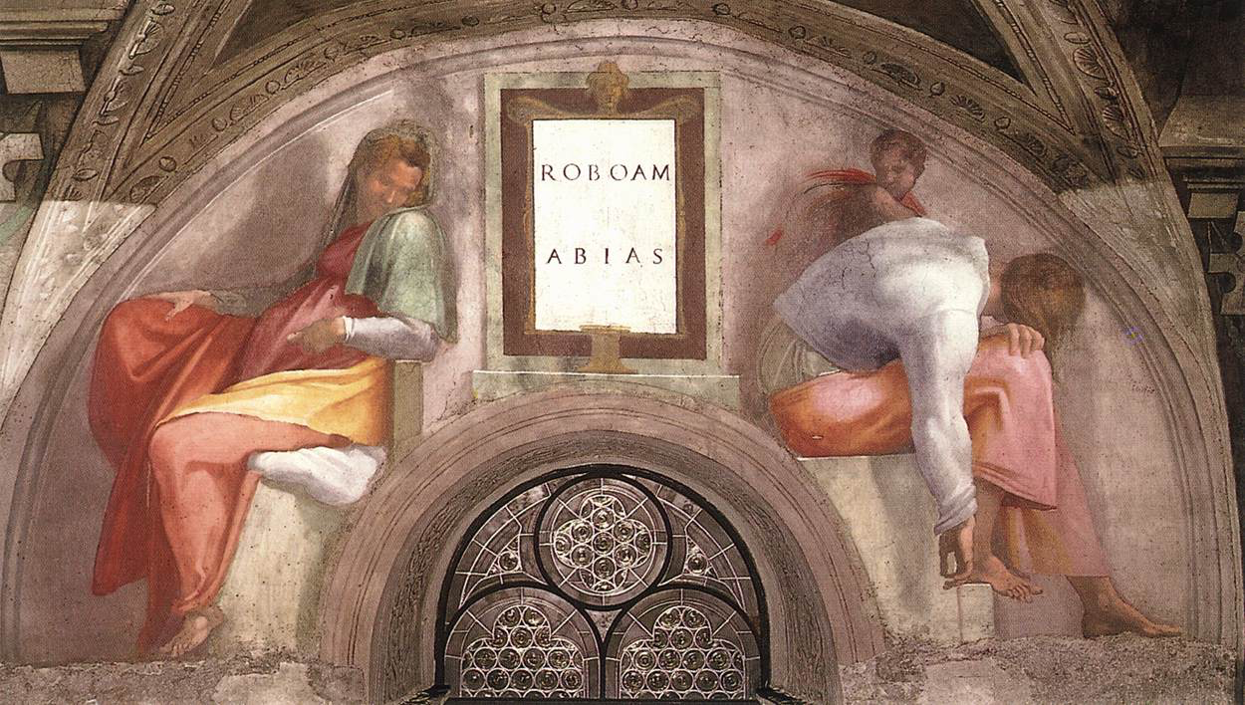

Slide 19
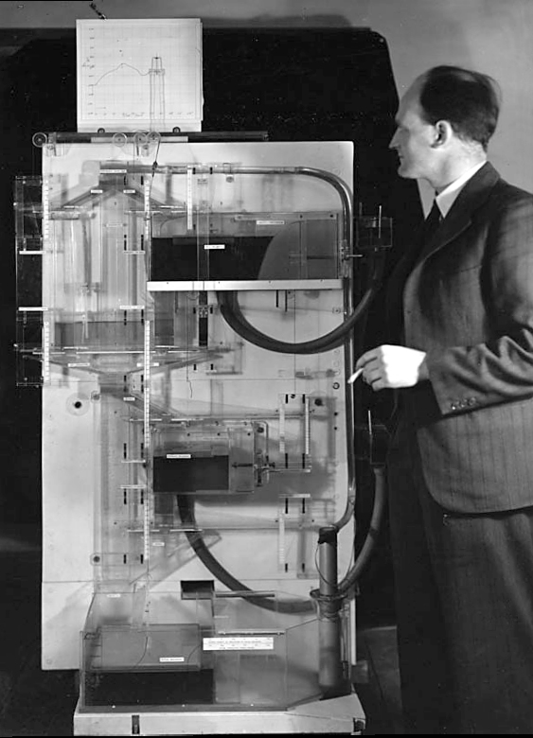
Notes:
Bill Phillips standing next to the MONIAC (completed in 1949)

Slide 21
psychology
classical
statistics
artificial
intelligence
data
science

Slide 22
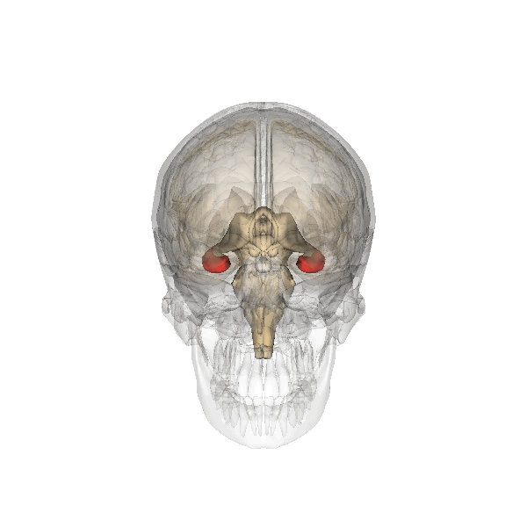

Slide 23


Slide 24
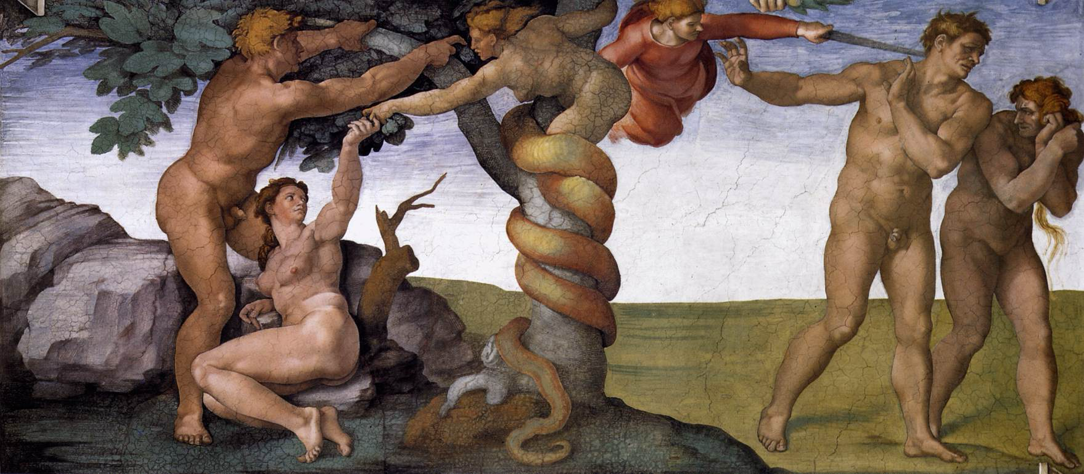

Slide 25
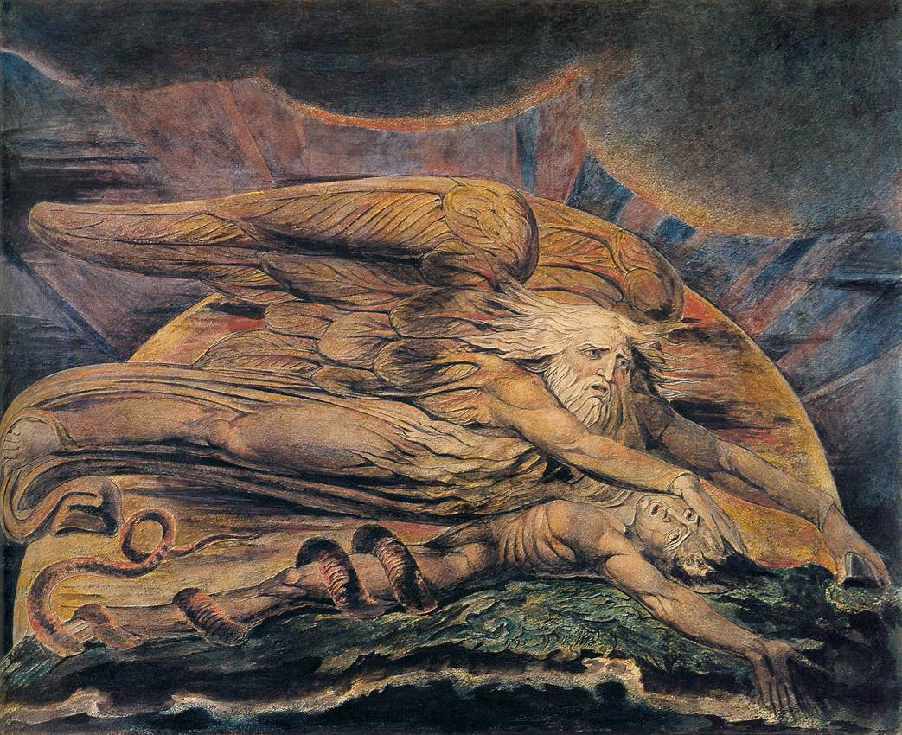

Slide 26
complexity
bandwidth

Slide 27

Available from 6th June 2024
Thanks!

